Slide 1
OOPs- Python

Slide 2
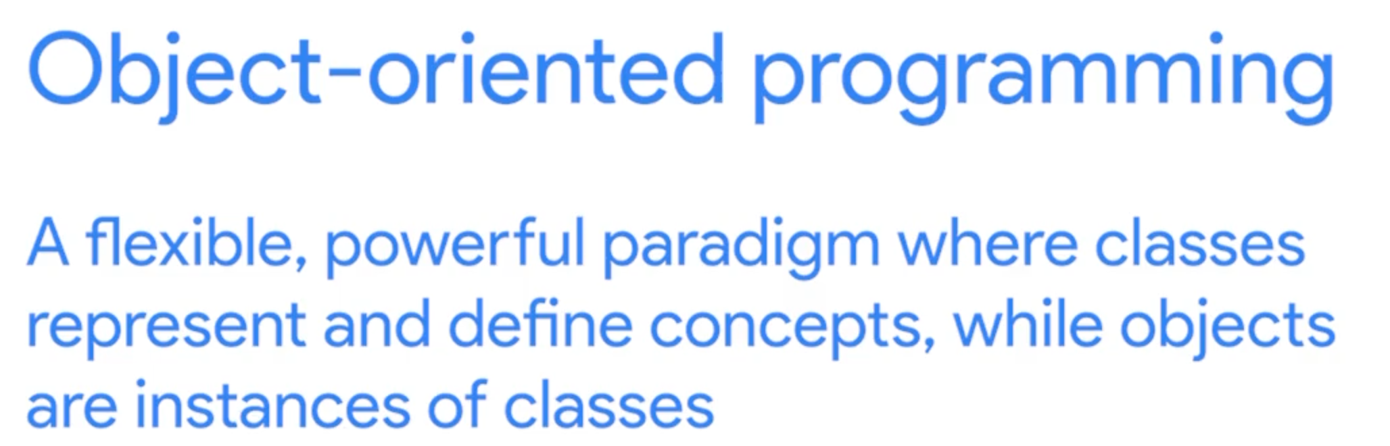

Slide 3
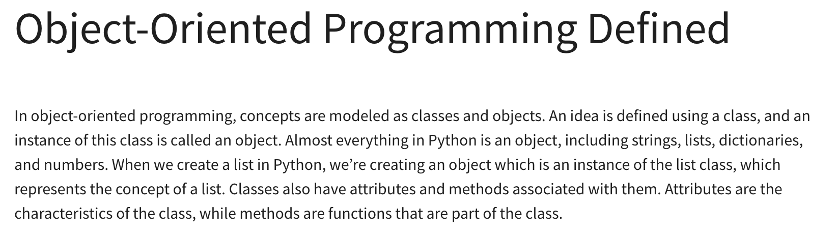

Slide 4
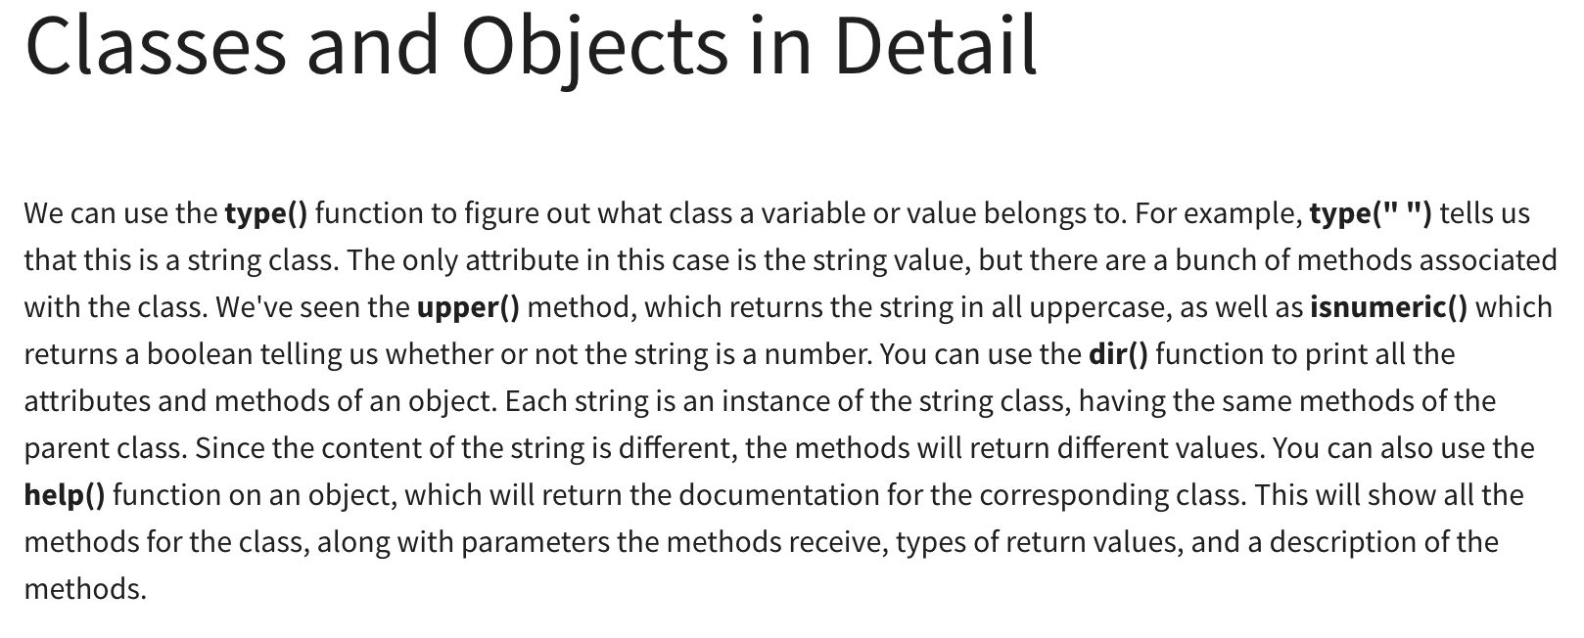

Slide 5
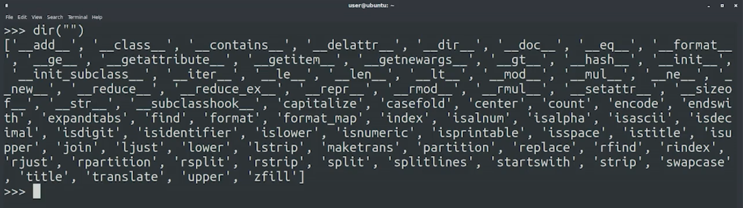

Slide 6
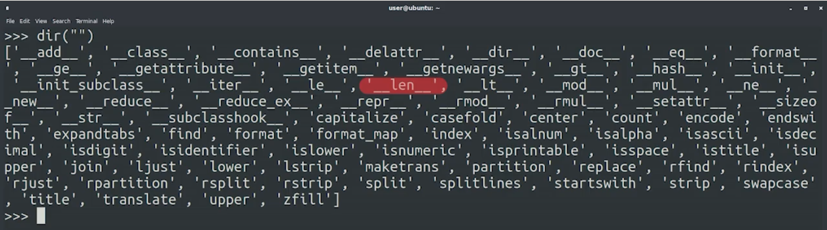

Slide 7
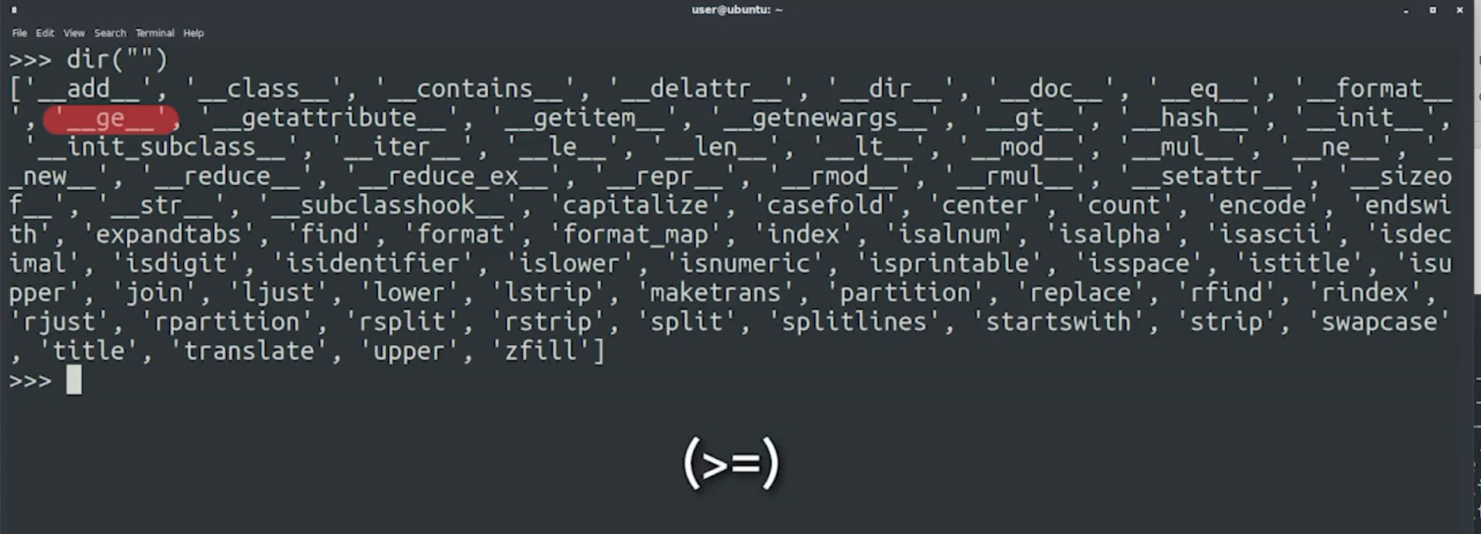

Slide 8
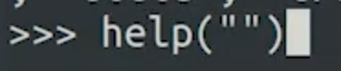
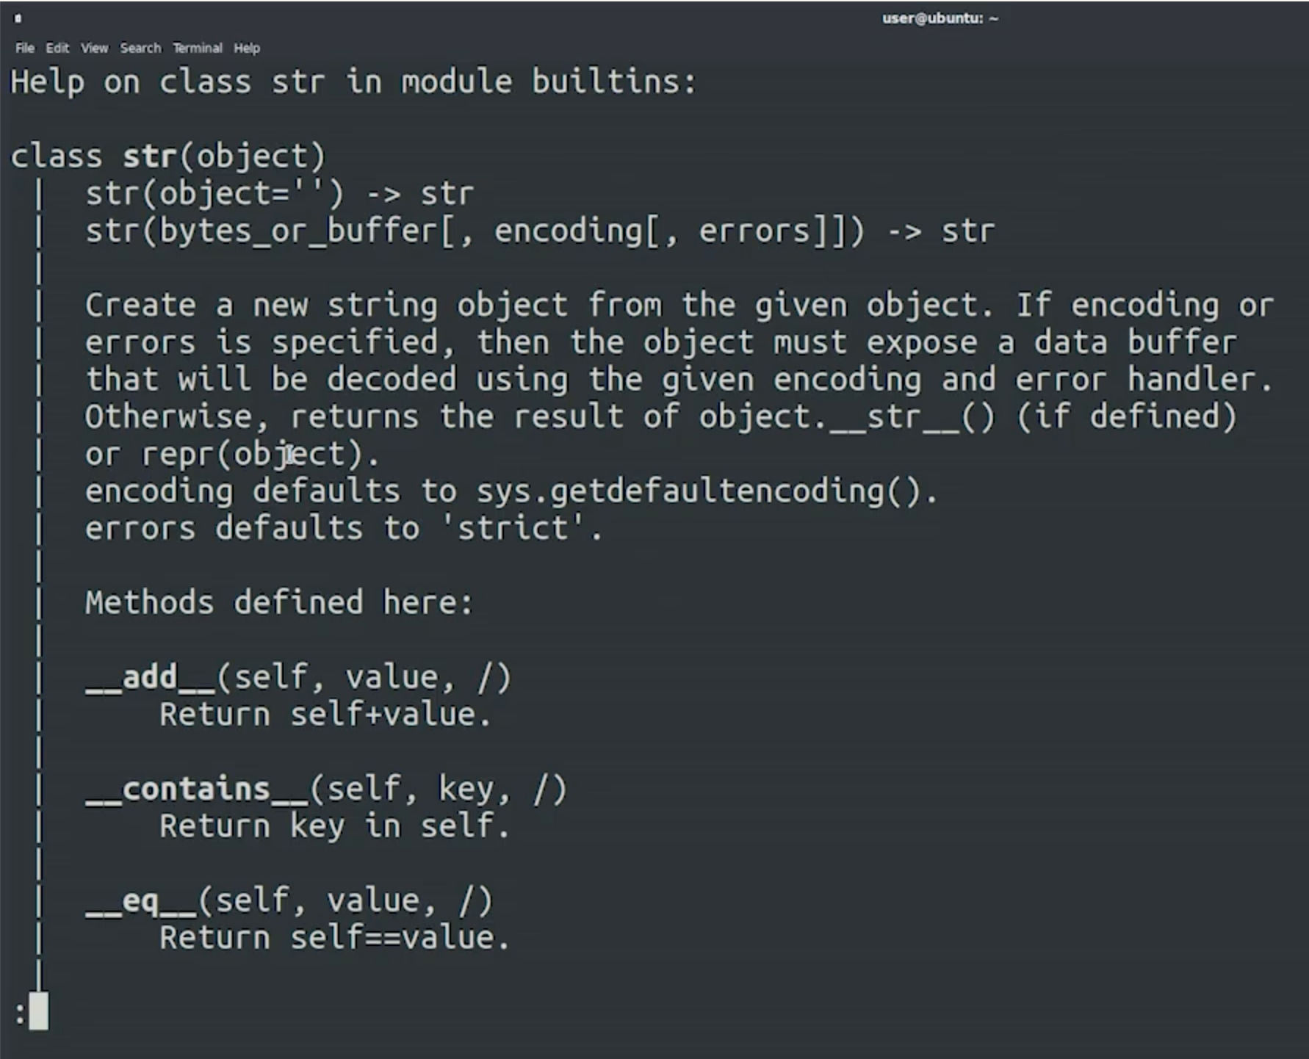

Slide 9
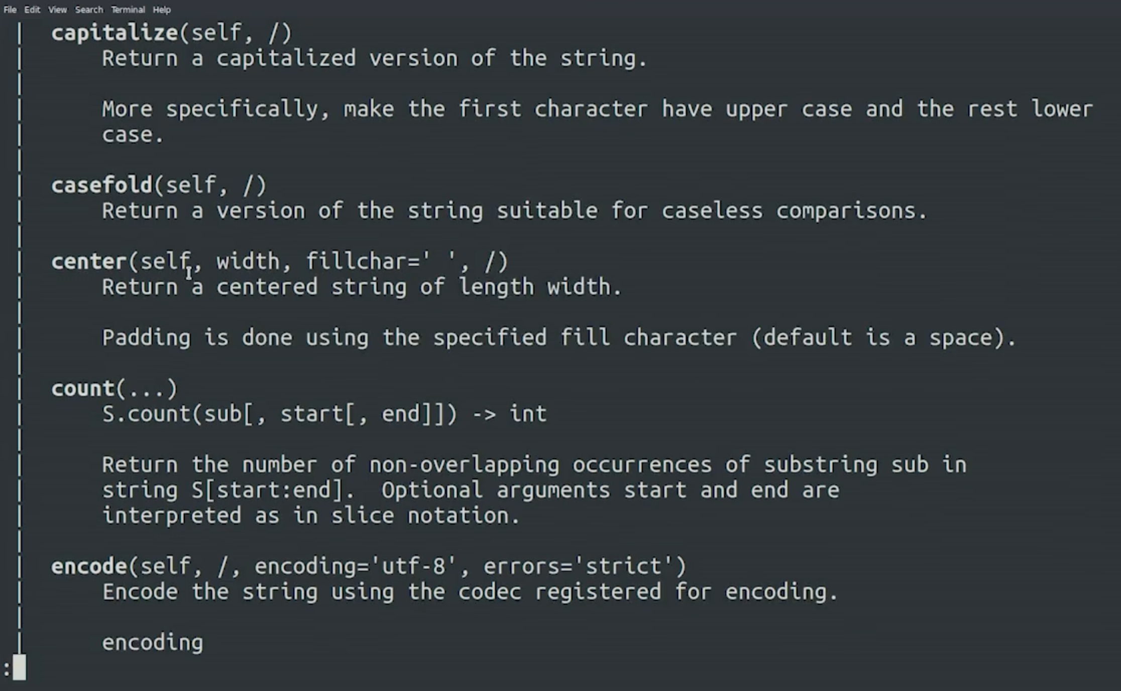

Slide 10
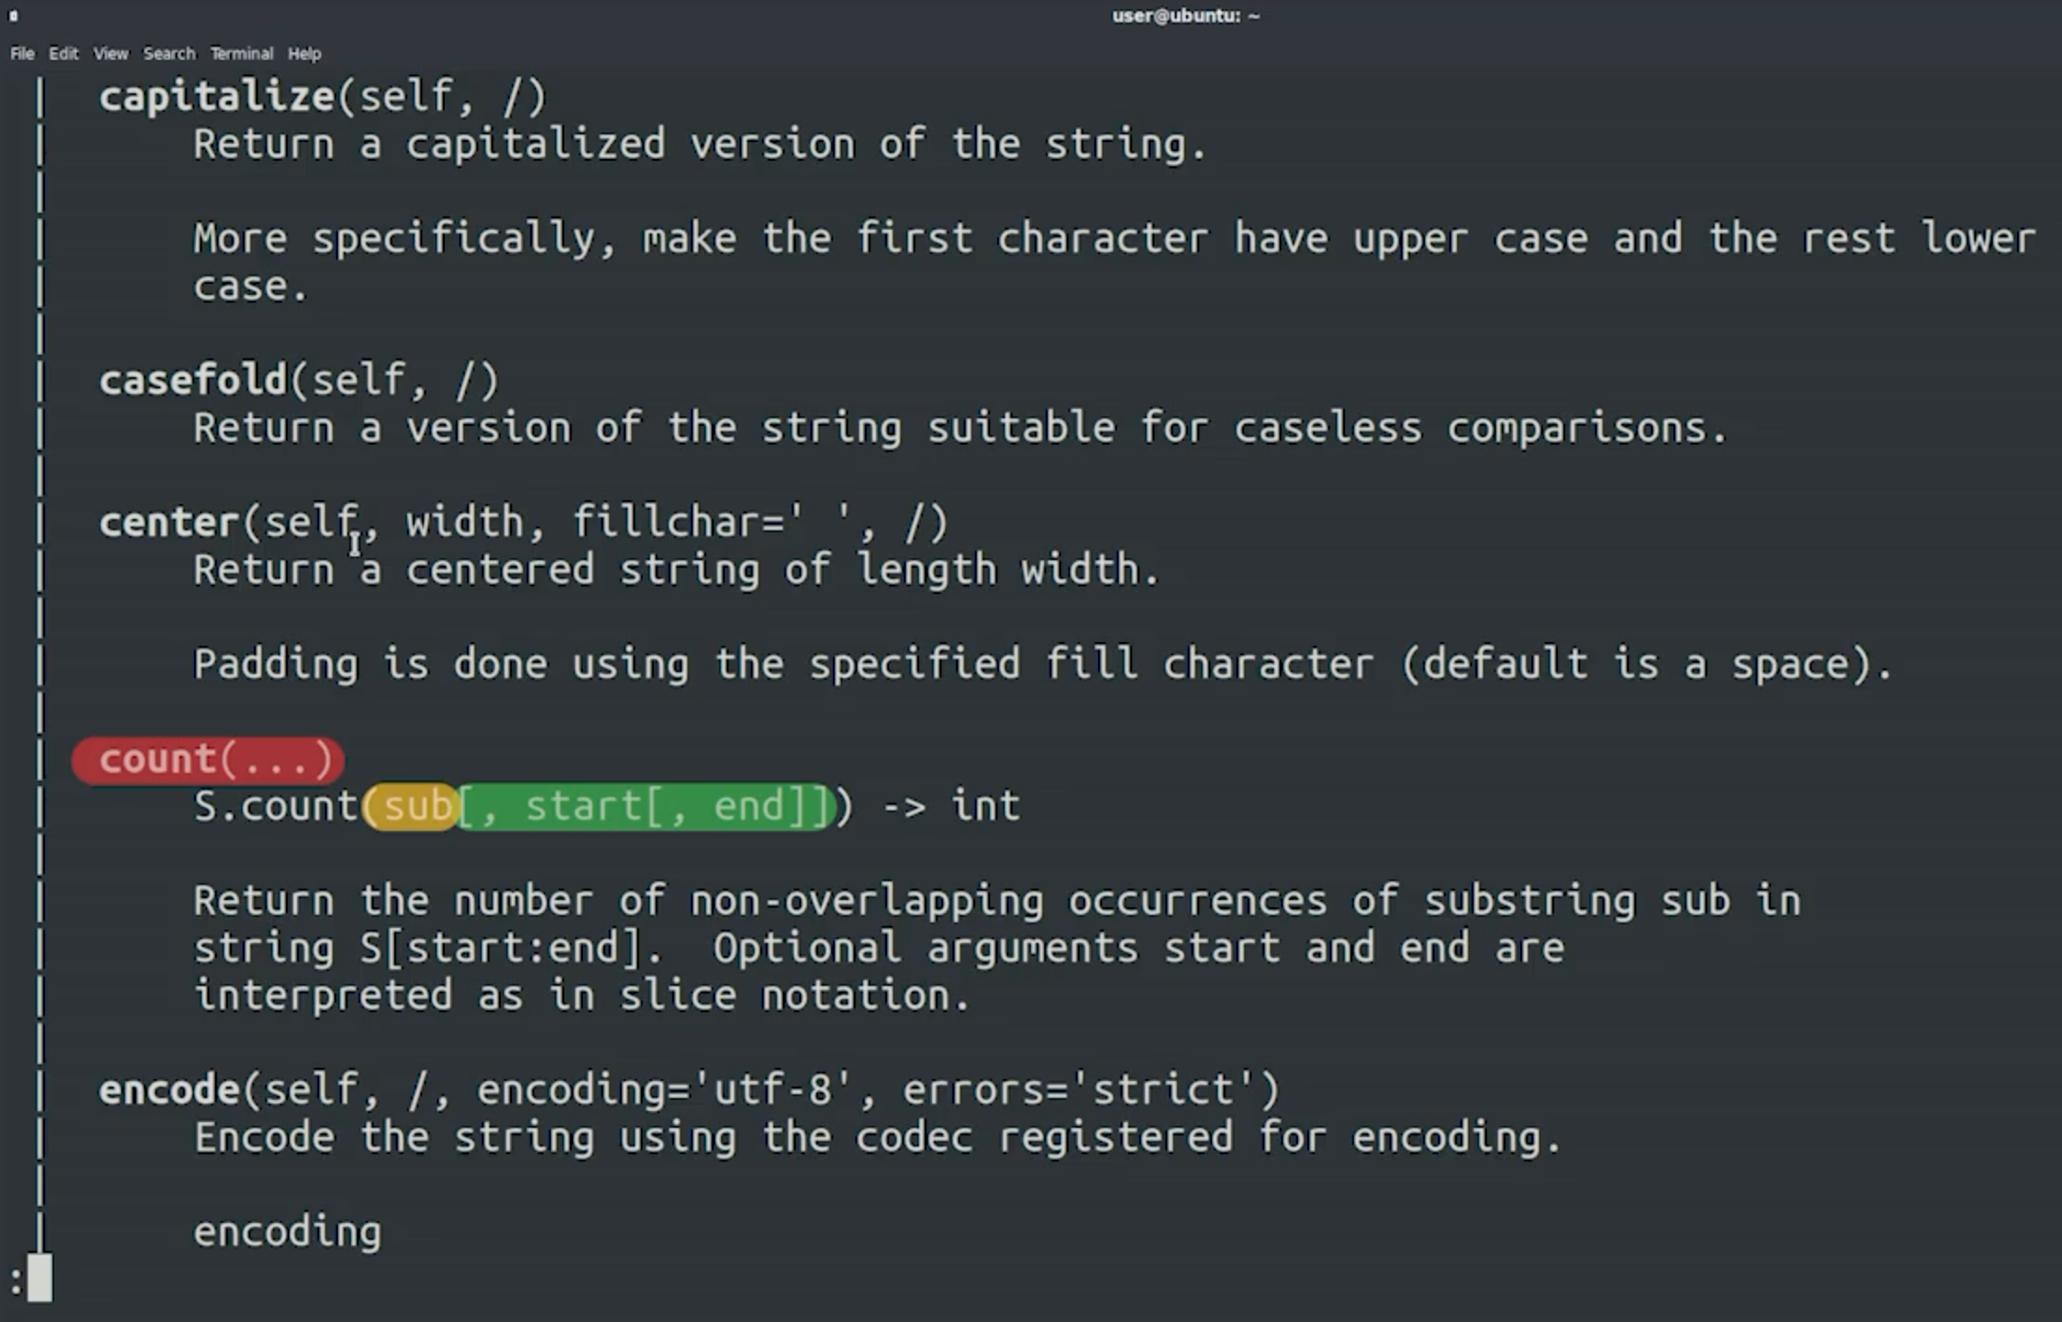

Slide 11


Slide 12
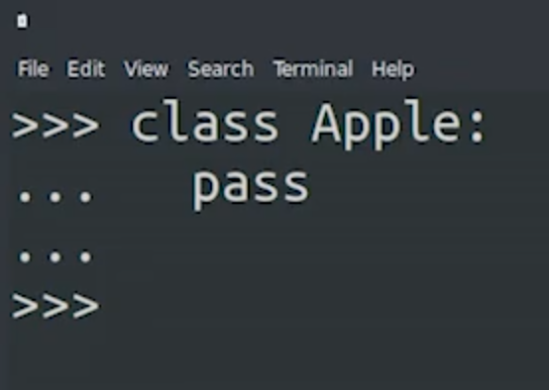
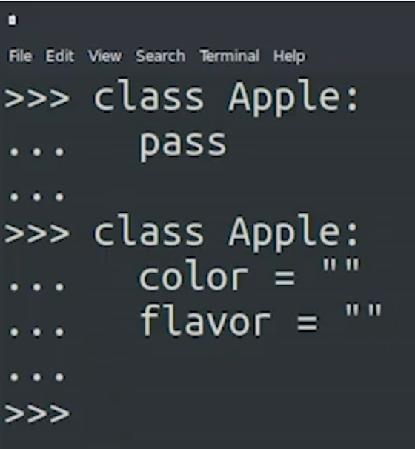
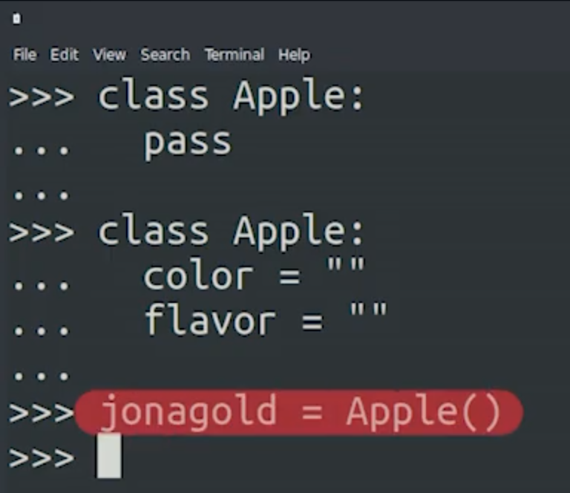
pass keyword to show body is empty
Any empty python block

Slide 13
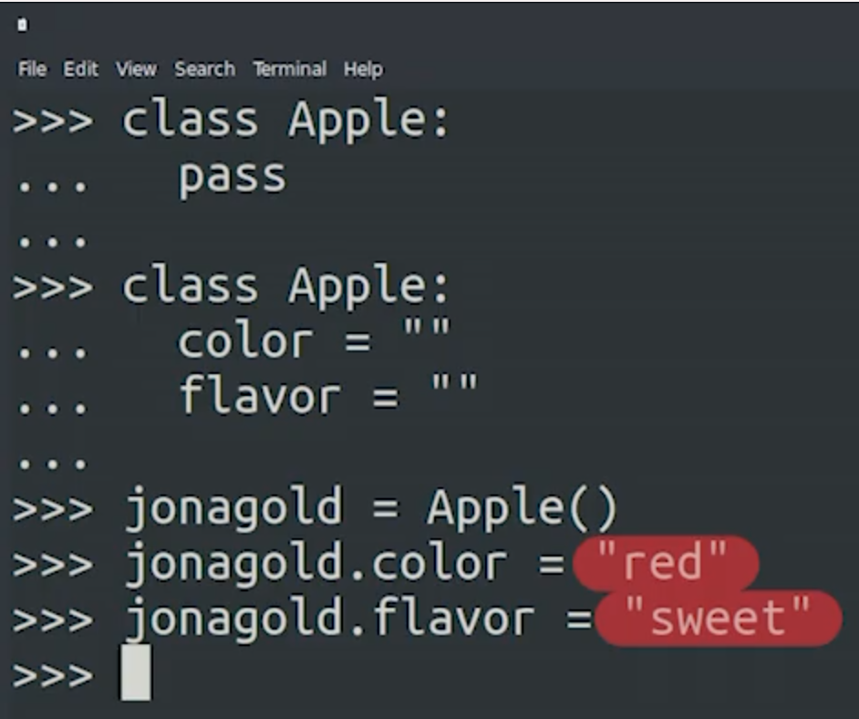
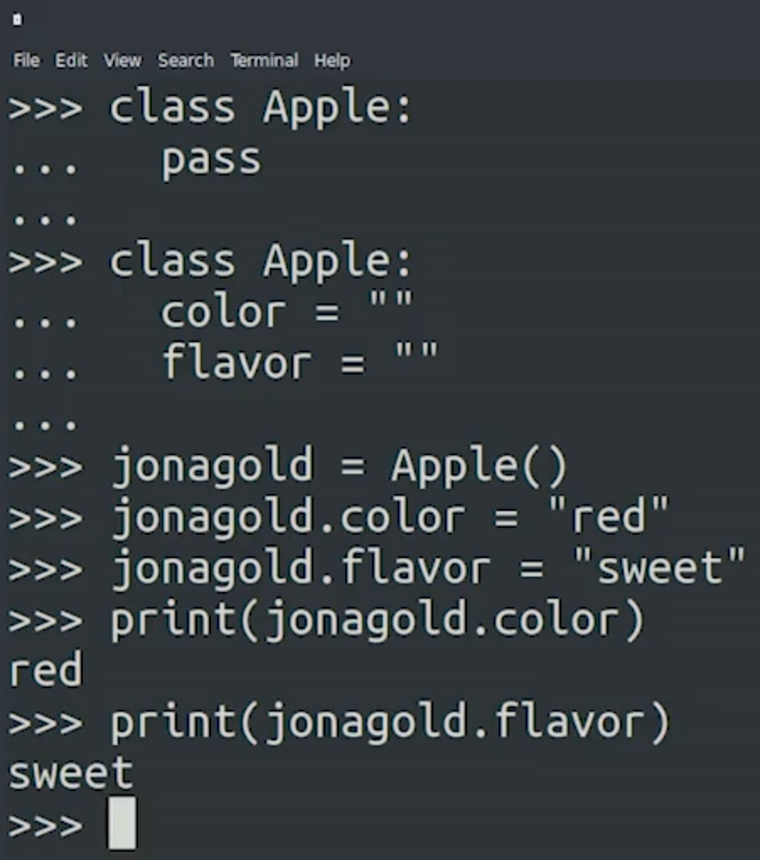

Slide 14
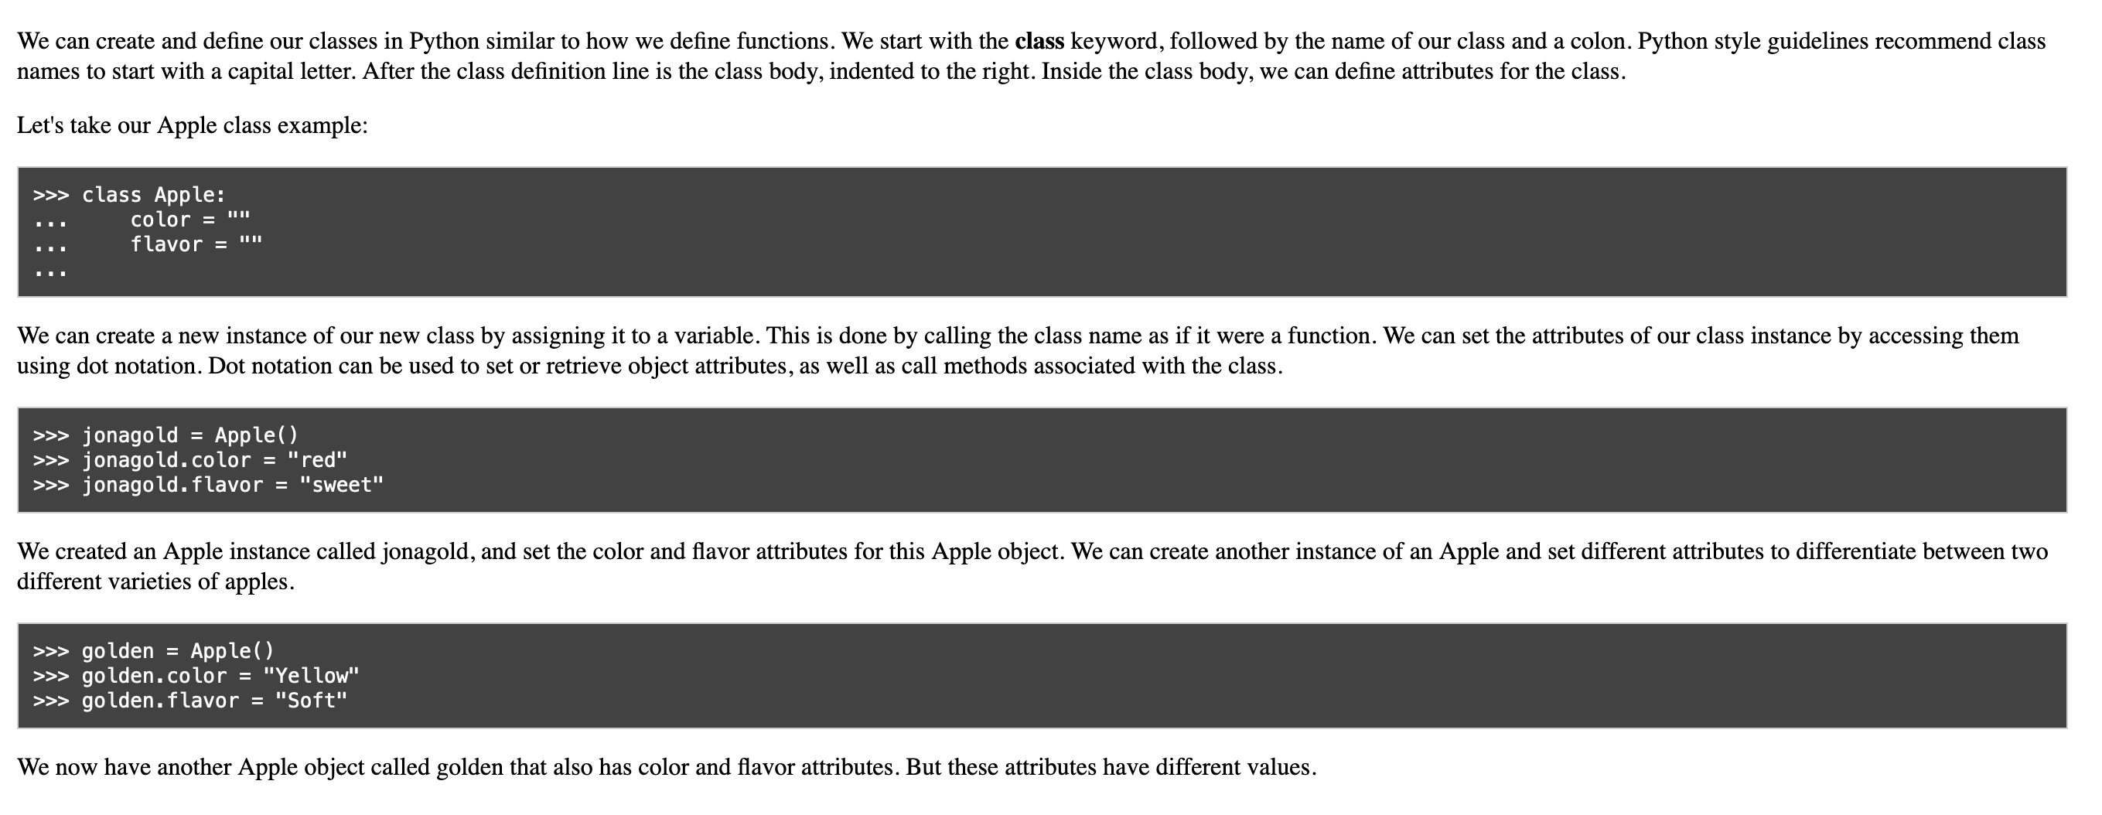

Slide 15
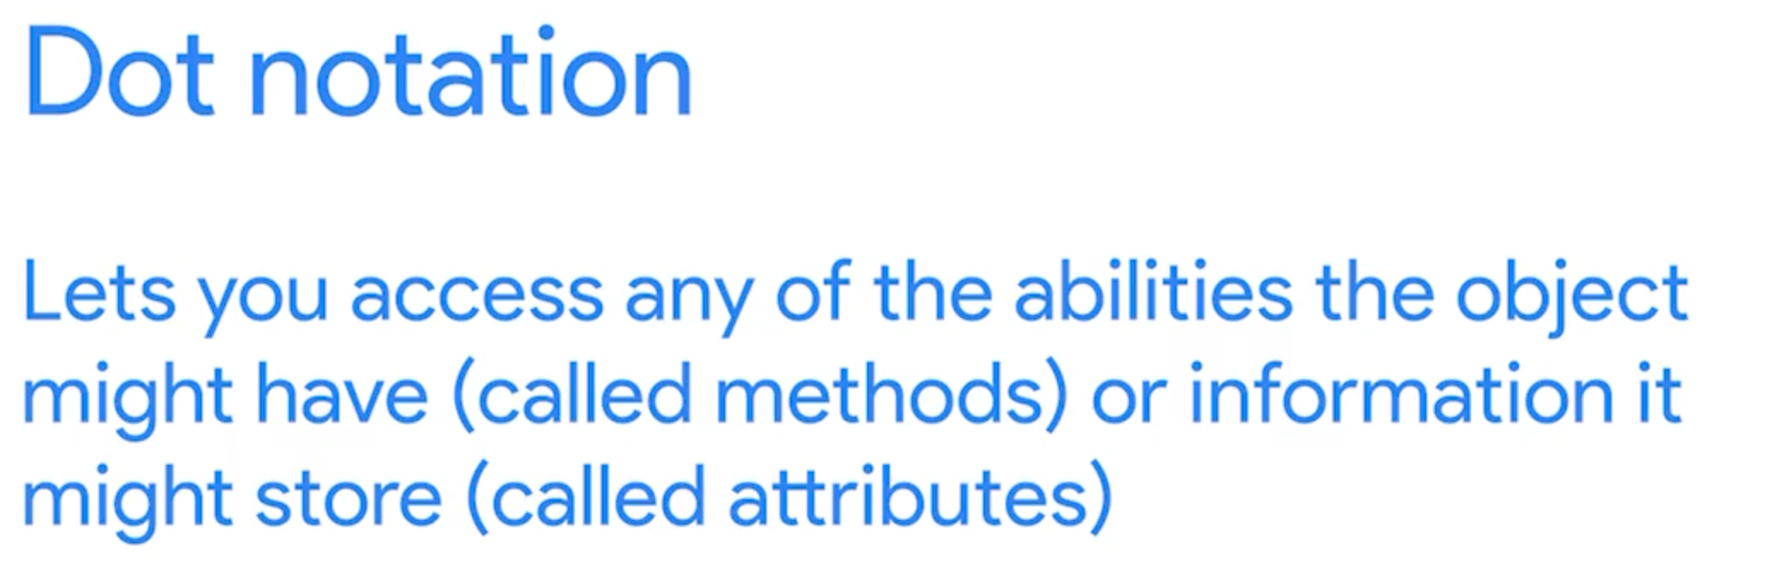

Slide 16
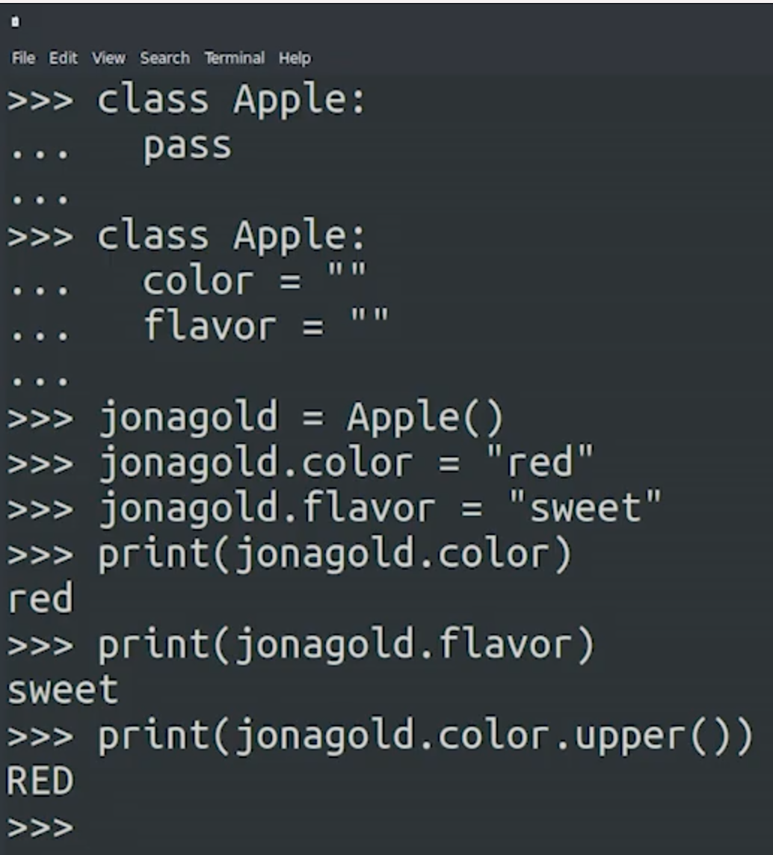
The attributes and methods of some objects can be other objects and can have attributes and methods of their own. For example, we could use the upper method to turn the string of the color attribute to uppercase. So print (jonagold.color.upper()).

Slide 17
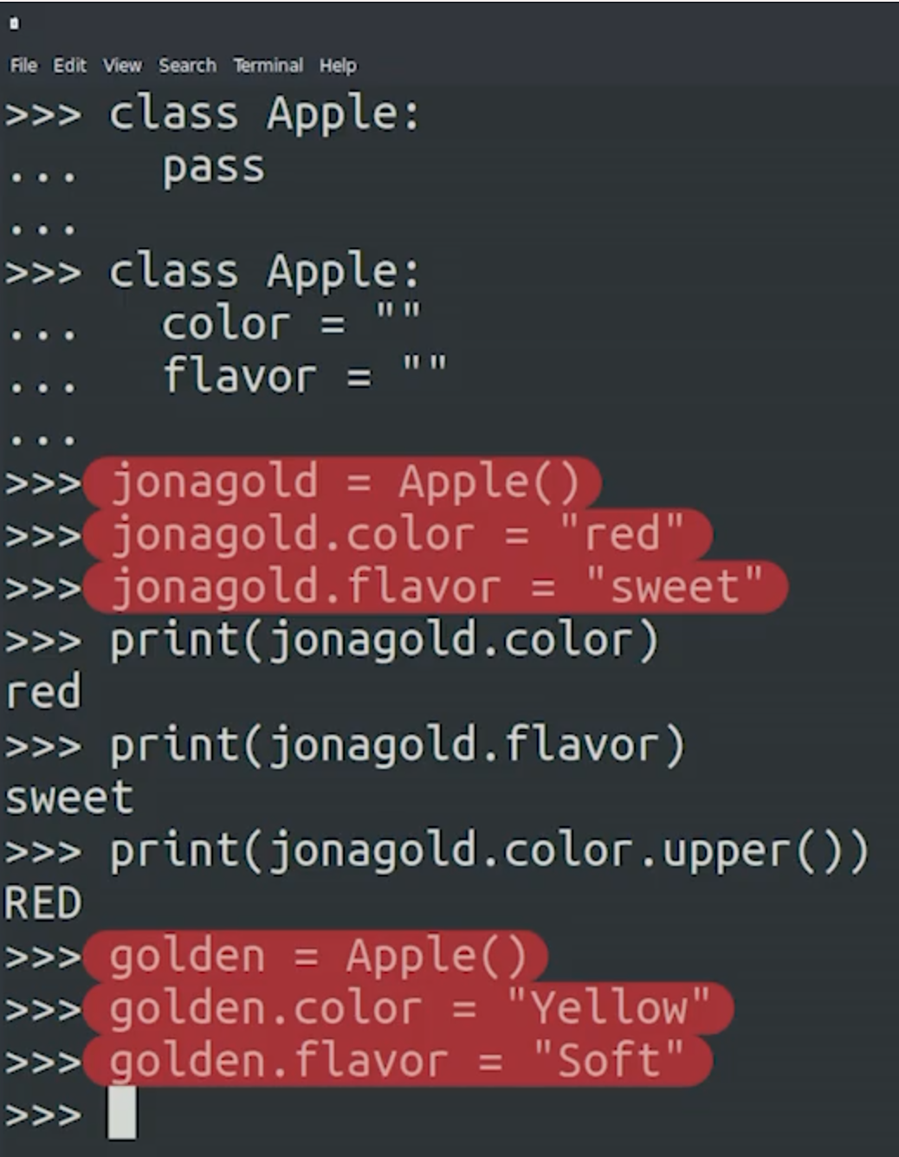

Slide 18
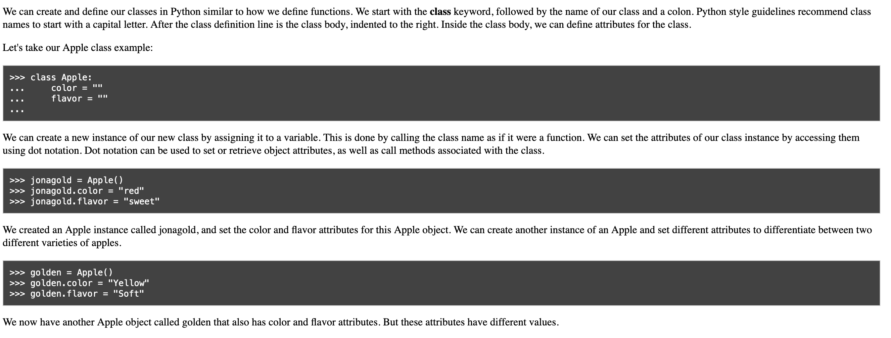

Slide 19
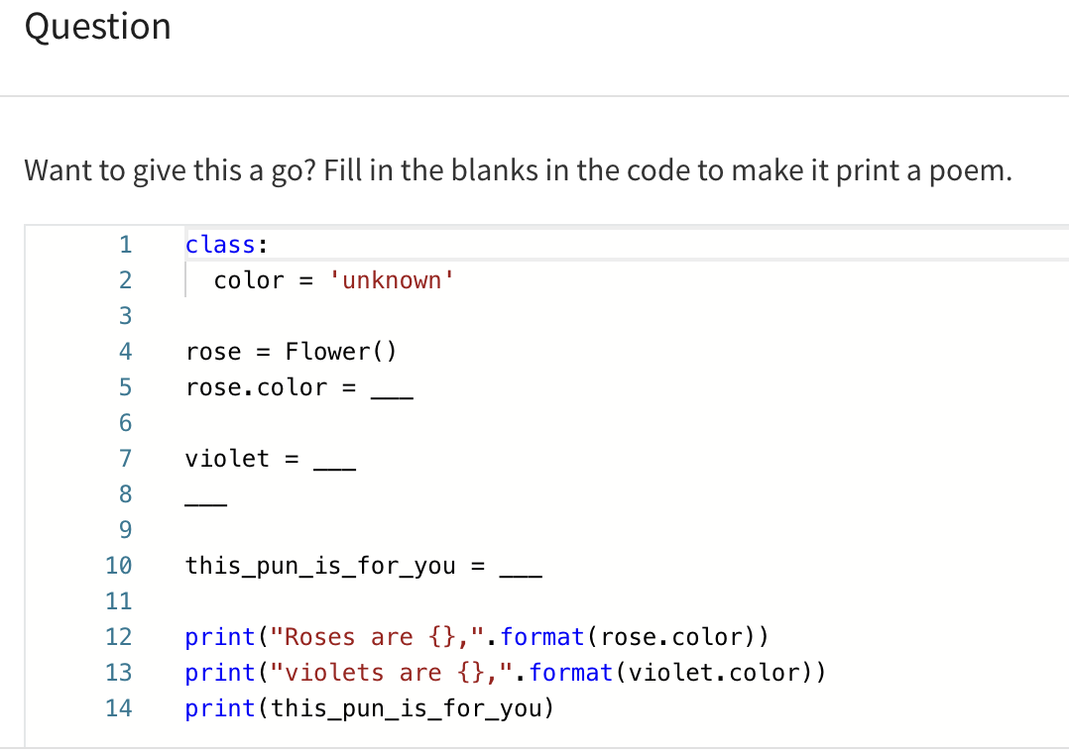

Slide 20
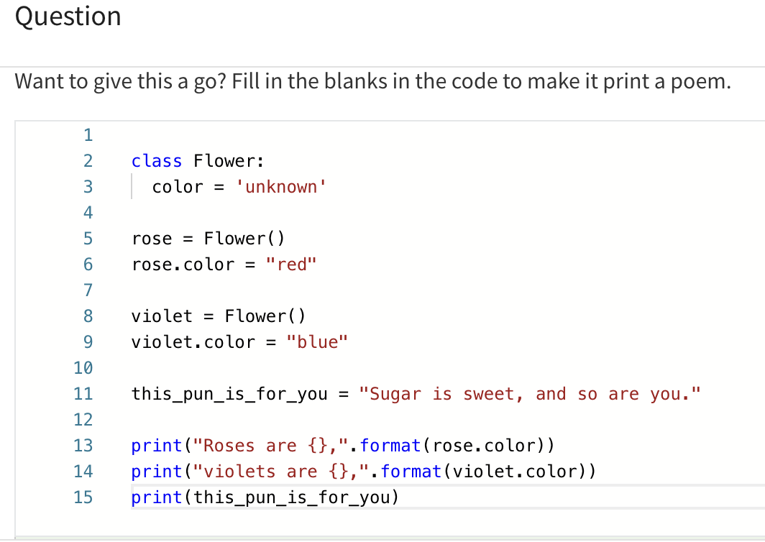

Slide 21


Slide 22
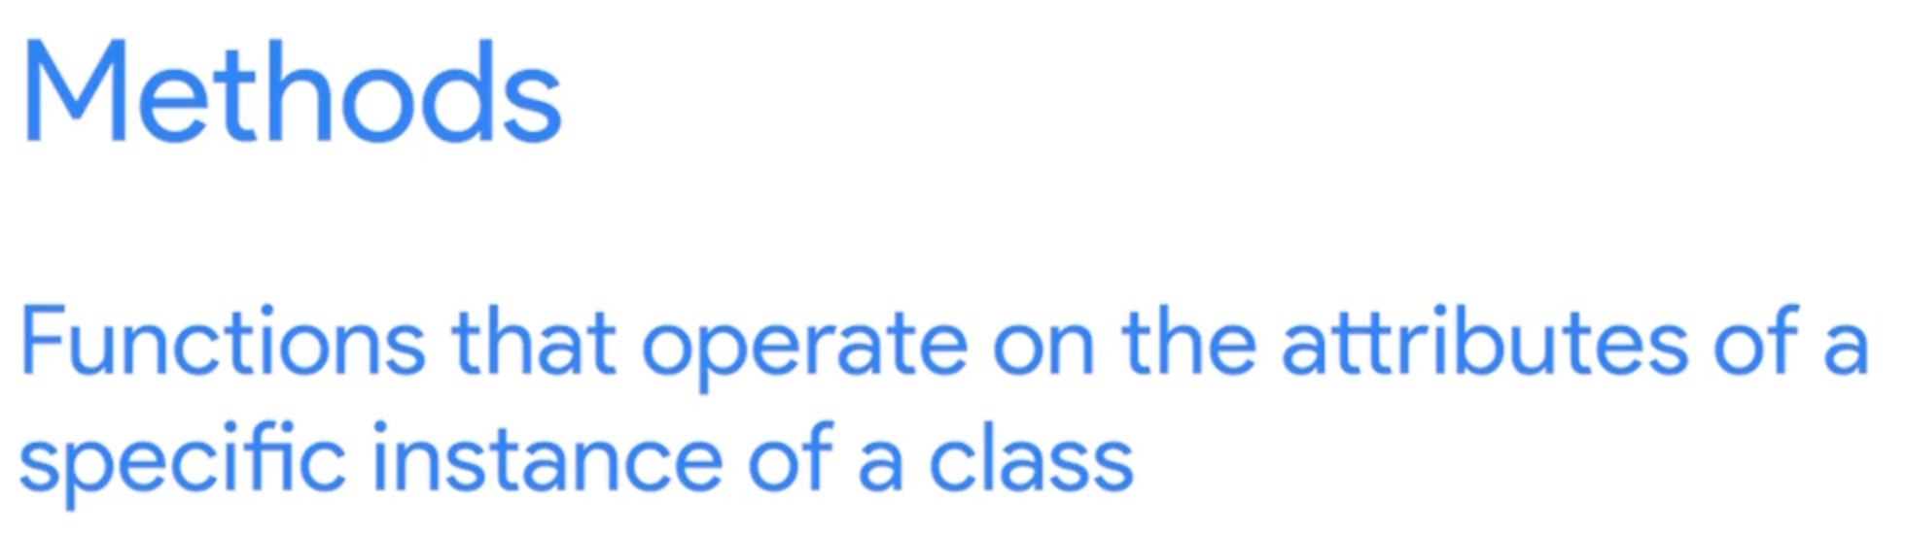

Slide 23
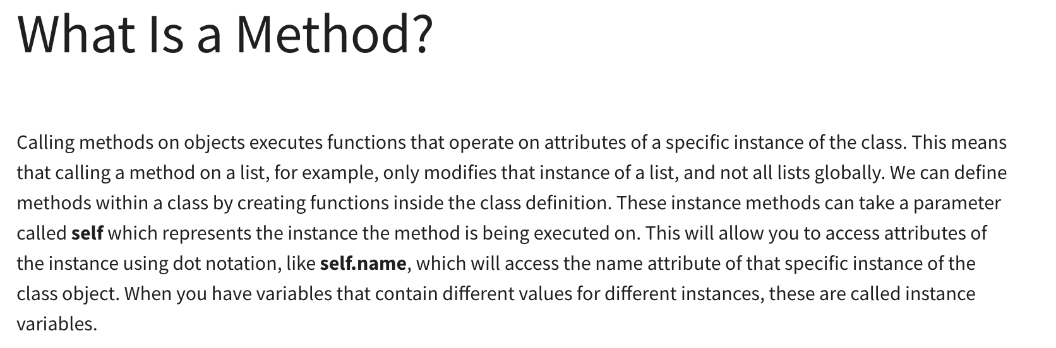

Slide 24
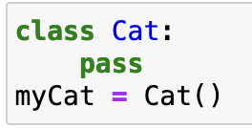
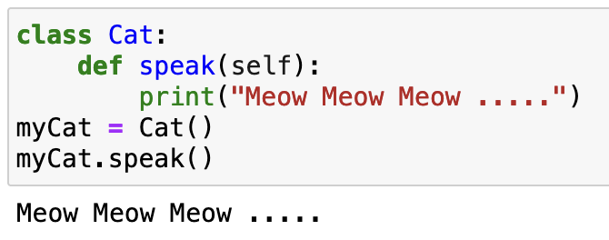
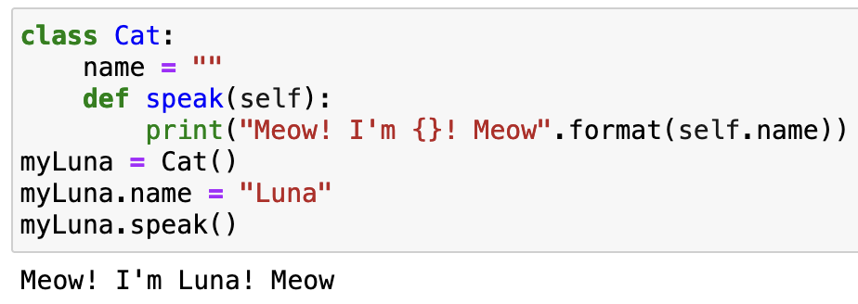
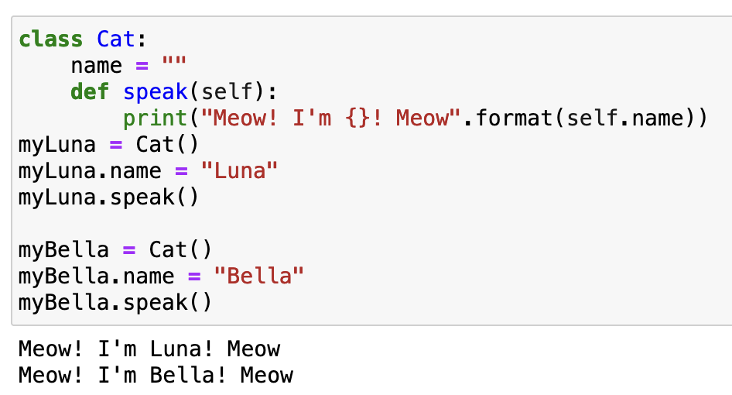

Slide 25
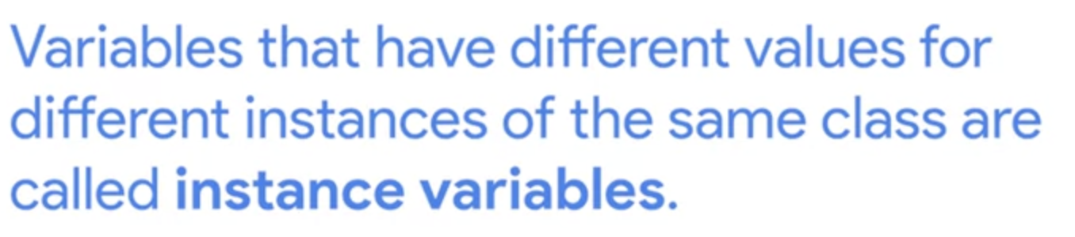

Slide 26
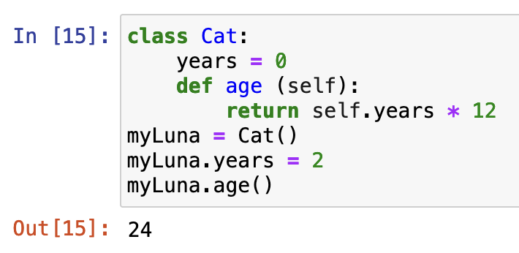
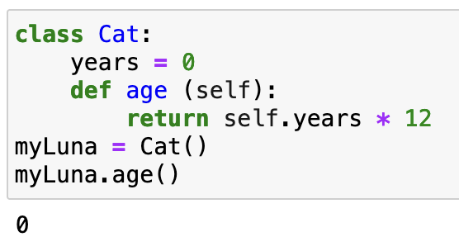

Slide 27
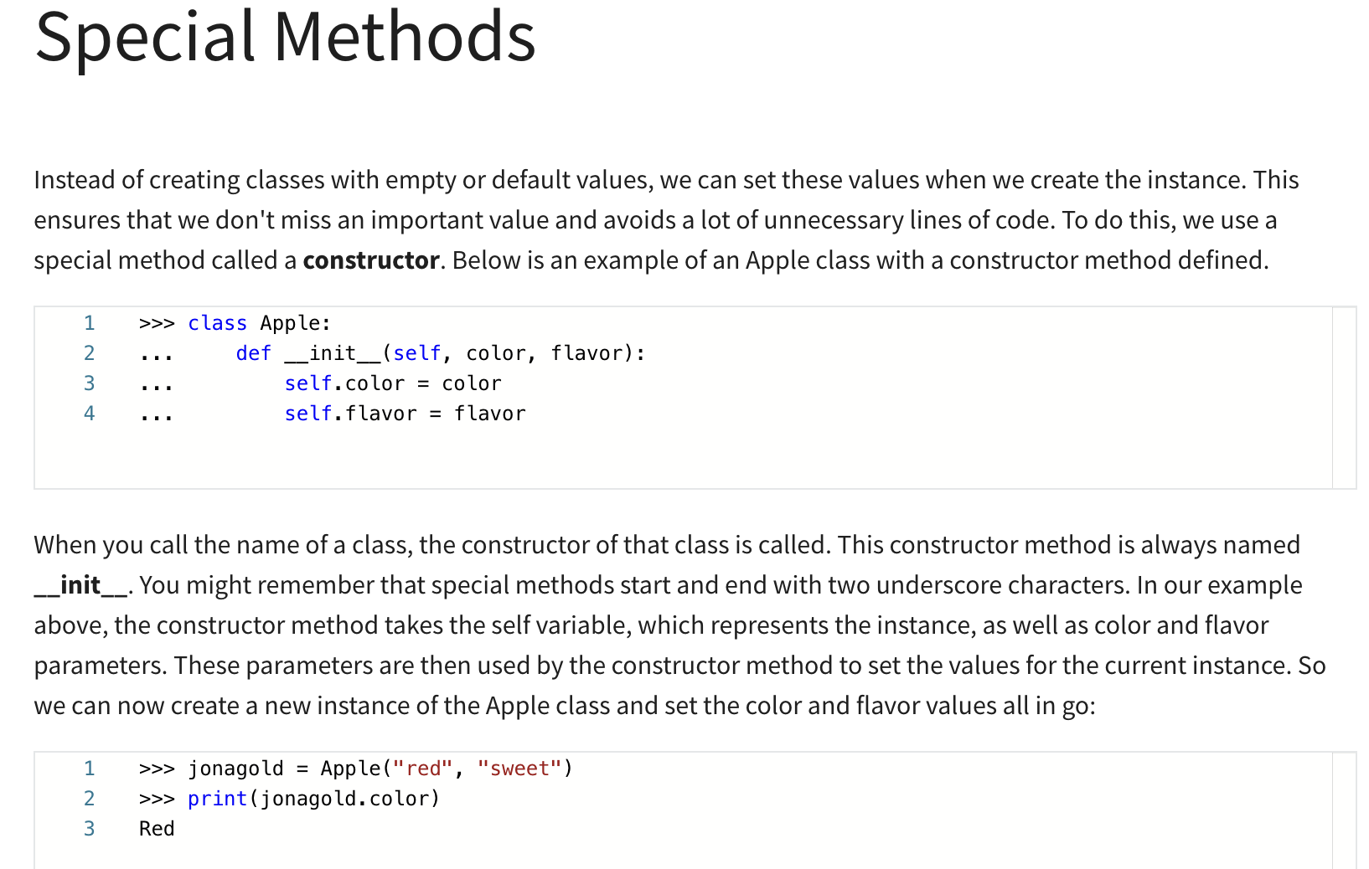

Slide 28
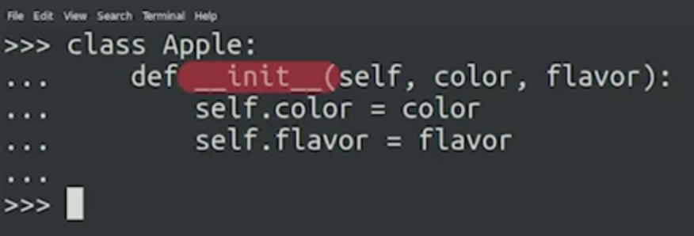
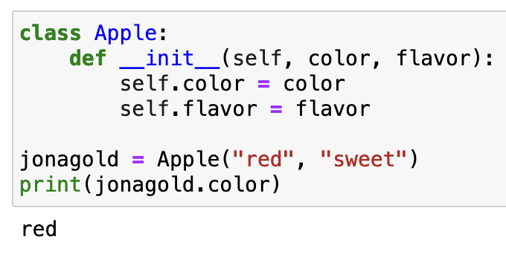
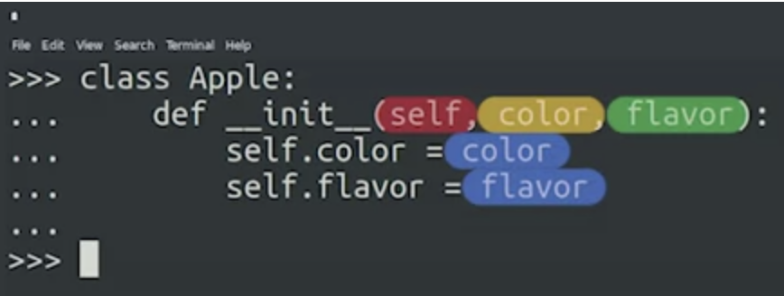
Special Method - Constructor

Slide 29
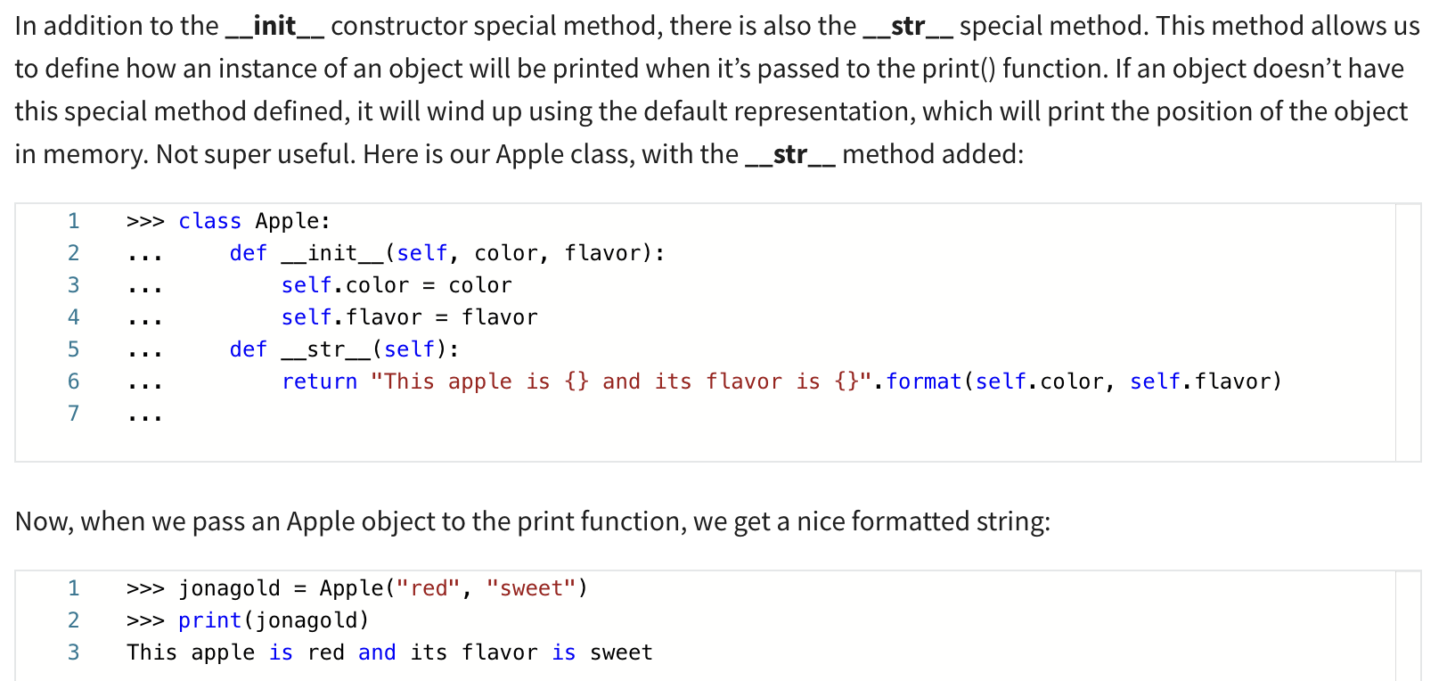

Slide 30


Slide 31
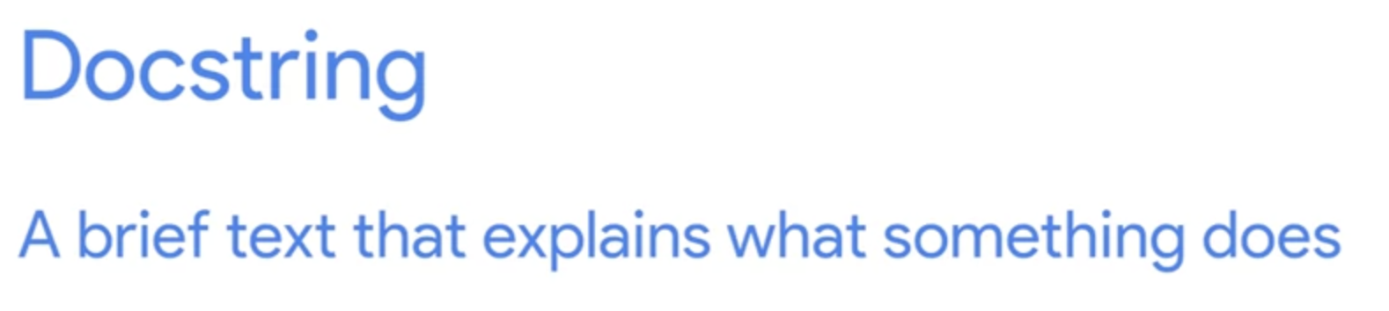

Slide 32
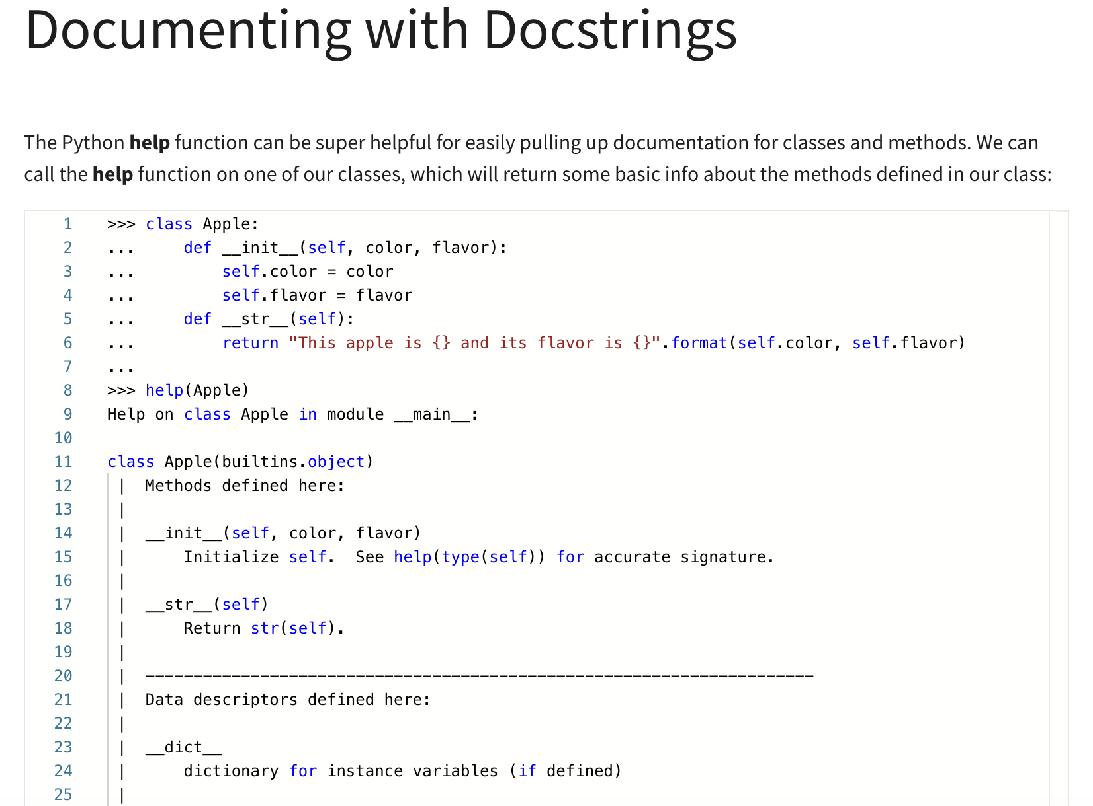

Slide 33
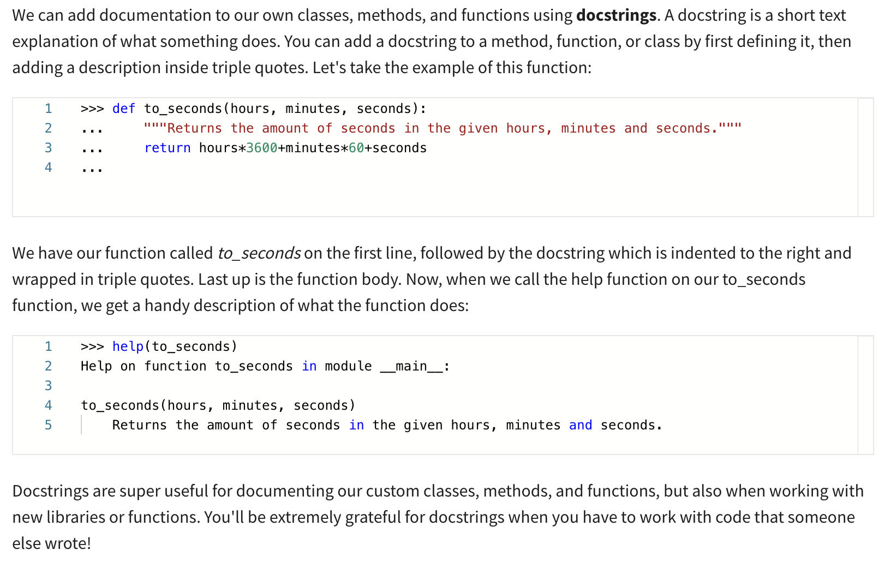

Slide 34
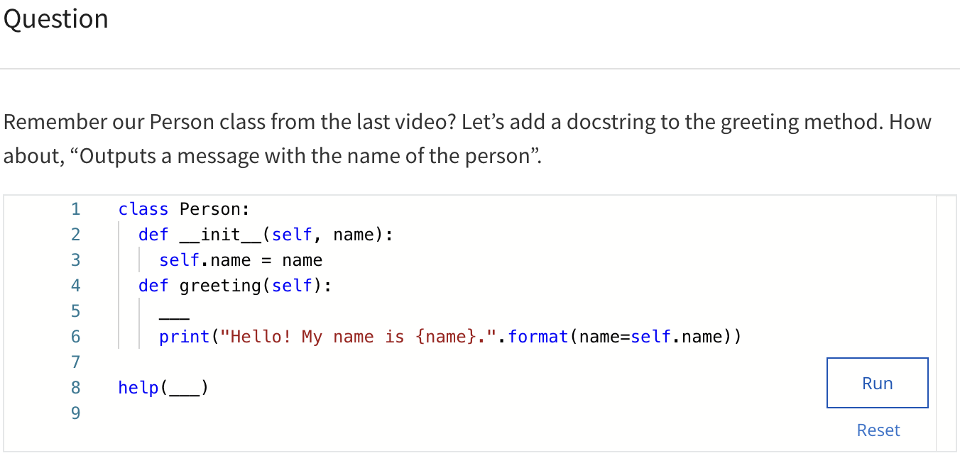

Slide 35
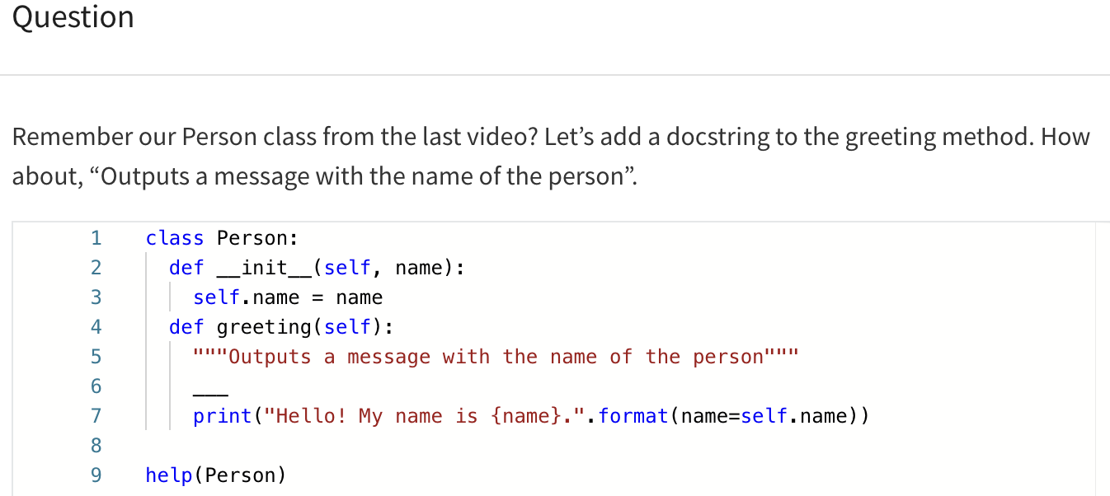

Slide 36
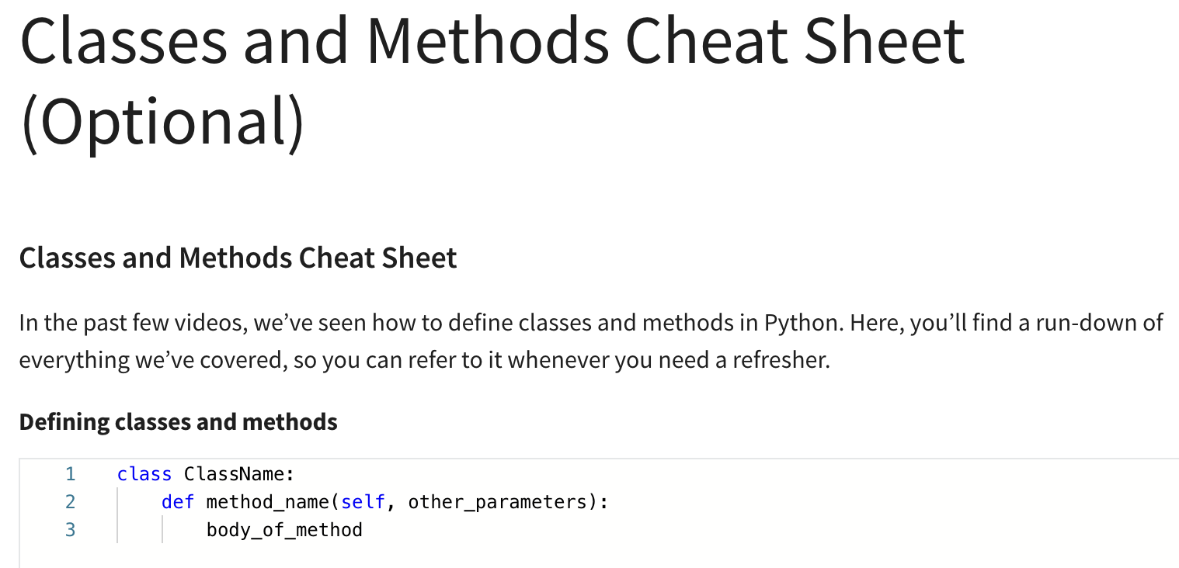

Slide 37
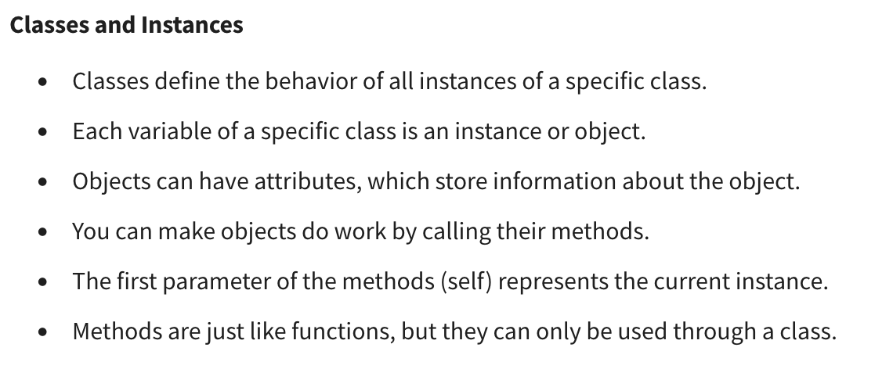

Slide 38
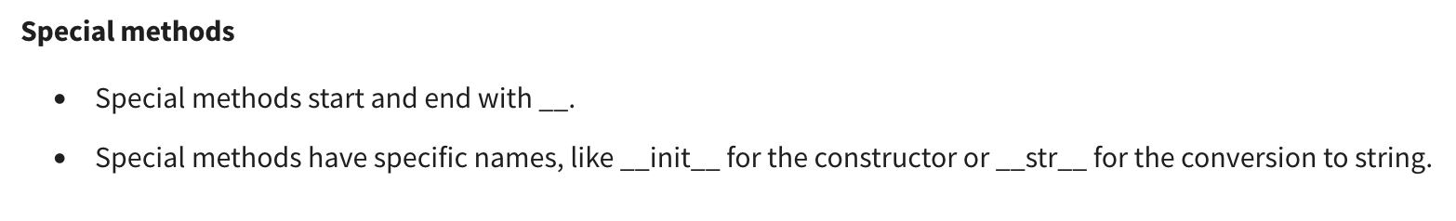

Slide 39
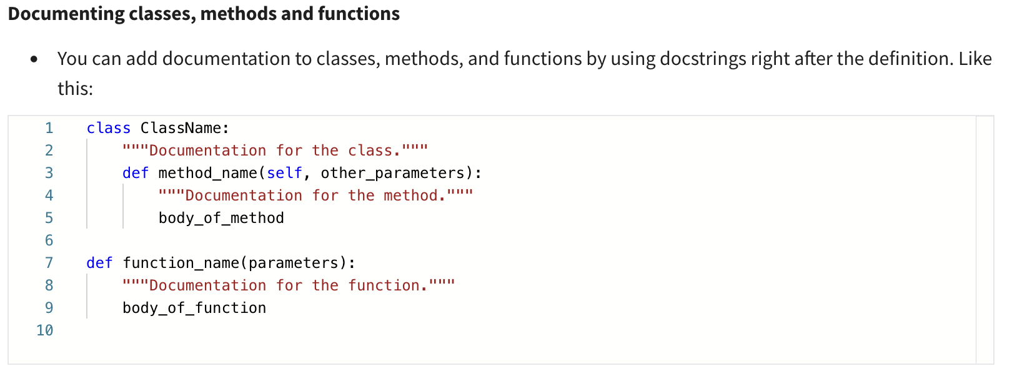

Slide 40
Inheritance
Inheritance lets you reuse code written for one class in other classes.

Slide 41
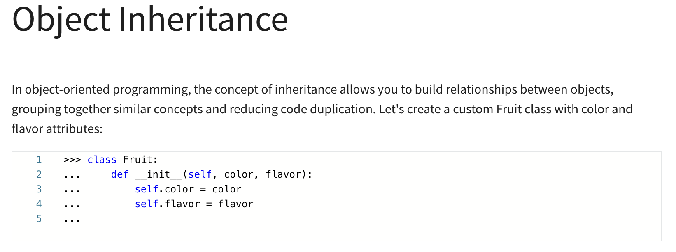

Slide 42
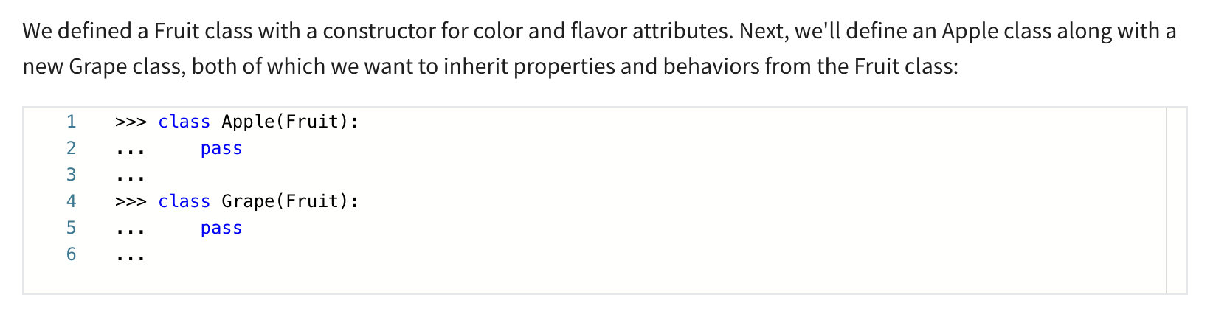

Slide 43
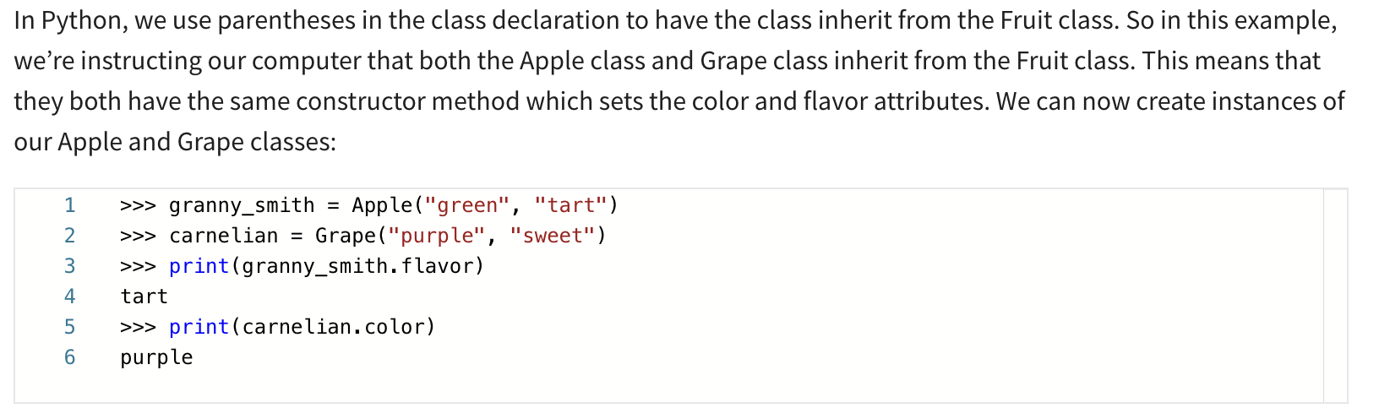
Inheritance allows us to define attributes or methods that are shared by all types of fruit without having to define them in each fruit class individually. We can then also define specific attributes or methods that are only relevant for a specific type of fruit. Let's look at another example, this time with animals:

Slide 44
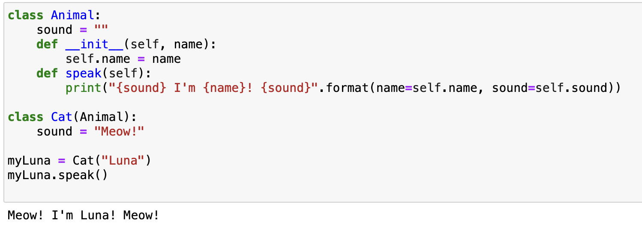
We defined a parent class, Animal, with two animal types inheriting from that class: Cat and Cow. The parent Animal class has an attribute to store the sound the animal makes, and the constructor class takes the name that will be assigned to the instance when it's created. There is also the speak method, which will print the name of the animal along with the sound it makes. We defined the Cat and Cow classes, which inherit from the Animal class, and we set the sound attributes for each animal type. Now, we can create instances of our Cat and Cow classes and have them speak:

Slide 45
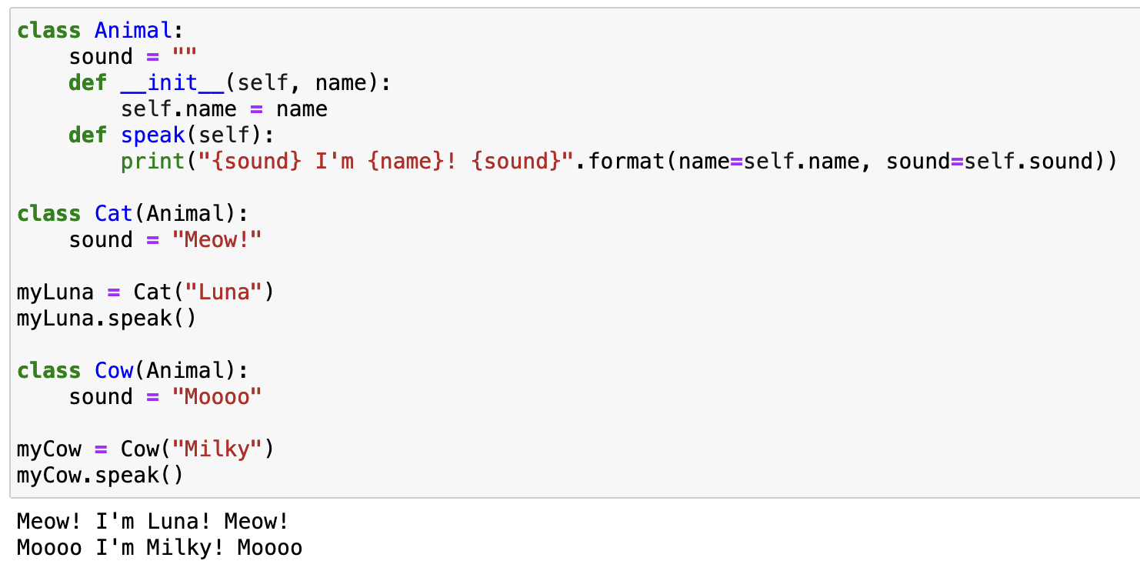
We create instances of both the Cat and Cow class, and set the names for our instances. Then we call the speak method of each instance, which results in the formatted string being printed; it includes the sound the animal type makes, along with the instance name we assigned.

Slide 46


Slide 47


Slide 48


Slide 49


Slide 50
In the constructor method, we initialize the packages dictionary, which will contain the package objects available in this repository instance.
We initialize the dictionary in the constructor to ensure that every instance of the Repository class has its own dictionary.

Slide 51
We then define the add_package method, which takes a Package object as a parameter, and then adds it to our dictionary, using the package name attribute as the key.

Slide 52
Finally, we define a total_size method which computes the total size of all packages contained in our repository.
This method iterates through the values in our repository dictionary and adds together the size attributes from each package object contained in the dictionary, returning the total at the end. In this example, we’re making use of Package attributes within our Repository class.
We’re also calling the values() method on our packages dictionary instance. Composition allows us to use objects as attributes, as well as access all their attributes and methods.

Slide 53


Slide 54


This function takes two integer parameters and returns a random integer between the values we pass it; in this case, 1 and 10. You might notice that calling functions in a module is very similar to calling methods in a class. We use dot notation here too, with a period between the module and function names.

Slide 55


Slide 56


Slide 57


Slide 58


